Slide 1

An Analysis of Japanese Loanwords
LING 1340 | Lindsey Rojtas

Slide 2
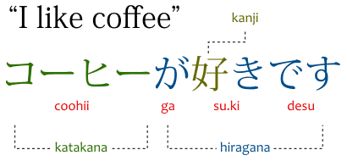

Terminology
Japanese has three writing systems:
Hiragana (ひらがな) - a Japanese syllabic script (meaning each character = one syllable) typically used for grammatical function words and words with no Kanji equivalent
Kanji (漢字) - logographic Chinese characters that are used in the Japanese writing system; different combinations can have different meanings or pronunciations (天 may be pronounced “ten” or “ama”)
Katakana (カタカナ) - a Japanese syllabic script used for onomatopoeia and loan words from languages such as English, French, Portuguese, etc.
Gairaigo (外来語) is the word for “loan word”/”borrowed word” specifically - this is what my project is on
Notes:
Elaborate on differences between the three writing systems

Slide 3
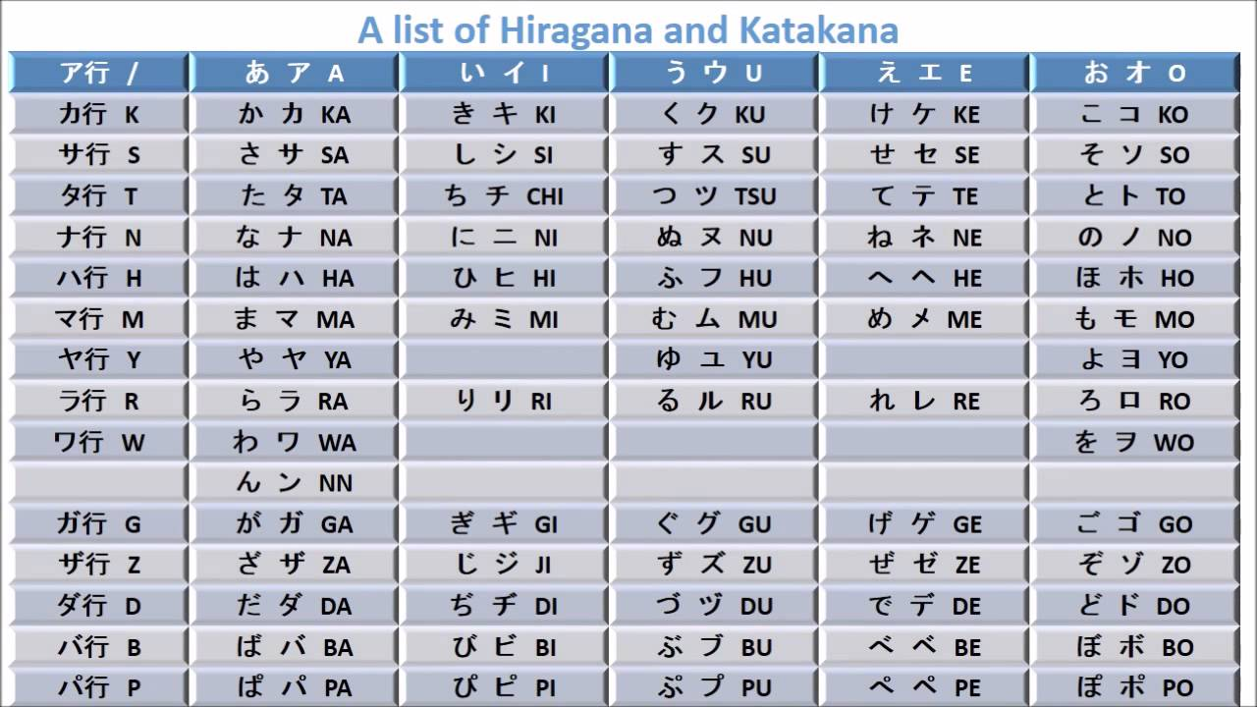
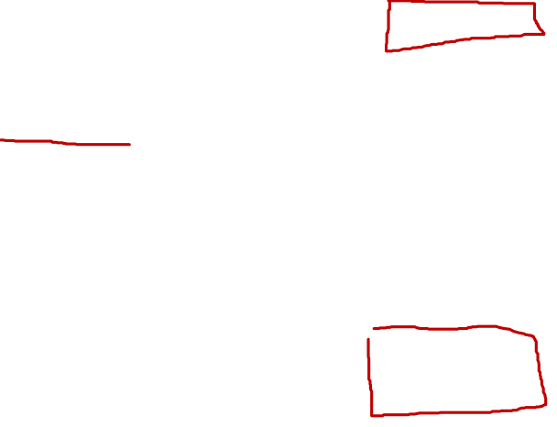
Notes:
Point out visual differences between the two

Slide 4
Motivation
Language borrowings was fun to learn about in LING1000
I watched a lot of anime as a middle schooler
The interest in the language stuck with me so I started teaching myself to read hiragana/katakana
I wanted to do something in non-English, but I can only read hiragana and katakana characters
Loanwords are easy to find and translate
Many borrowings from English just sound like the English word in a Japanese accent
トイレ = toire = toilet
English was introduced into Japanese society relatively recently, but some Japanese people will use English words instead of their Japanese equivalences
レッド (reddo) vs 赤 (aka) - both mean red, but the former is borrowed from English
Is the usage of one over the other related to age?
Some loanwords are shortened if they’re a bit long
プロレス (puroresu) = professional wrestling - we don’t say “pro-res” in English
What determines whether or not a word is shortened?
Notes:
Language borrowings especially interesting with regard to different families of language borrowing into one another - English and Japanese are very different languages
Considered doing political climate as other project alternative, but figured things would change a bit too fast in the weeks we had in class

Slide 5
Big Questions and Hypotheses
HYPOTHESIS 1: Shorter versions of katakana words will be used more often than longer words, since these shortened words are likely easier to say than their longer counterparts.
HYPOTHESIS 2: Age and the amount of katakana words used are related; younger Japanese speakers will use these katakana words more than older speakers. This correlation may not be horribly strong, so a machine learning model may not be effective at age prediction
Are shortened versions of katakana words more likely to be used in casual Japanese conversation?
Are age and the amount of katakana words used correlated in any way?
If so, can we use a machine learning model to predict an age based off katakana words used?

Slide 6
My Data
I used two corpora in my project:
The Nagoya University Conversation Corpus
129 unstructured conversations with several different participants of varying age groups
Ages range from late teens to early nineties
Most participants are female
Balanced Corpus of Contemporary Written Japanese - Word List
A list of words and their web-based frequencies, as well as some other arbitrary data
Reddit user u/Alphyn provided a cleaned version that made my life way easier!
List of words used because Japanese has no word boundaries - no way to tokenize
Also got the idea to compare web frequencies and conversational frequencies later on from this!

Slide 7
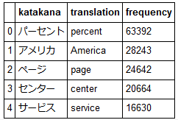
Data Cleaning and Reorganization
Word list was relatively easy to work with
Dropped irrelevant columns
Renamed columns that were relevant
Dropped words without any English equivalent (names, Japanese cities)
Dropped words with a web frequency of less than 75
Ended up w/ approx. 5000 words

Slide 8
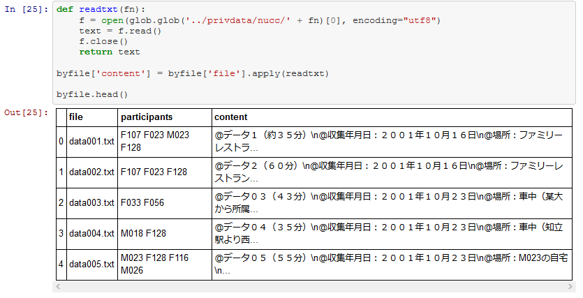
Data Cleaning and Reorganization
Conversational data was much more of a process
Created my own .csv files
My conversation corpus was only text files; I wanted to organize those contents by which file they were in and which participants they were spoken by
Tedious, but way worth it
Imported in text data, but ran into many issues trying to clean it …

Slide 9
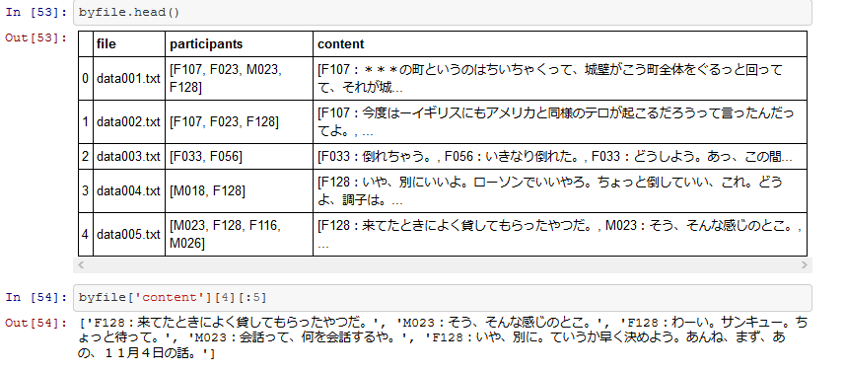
Data Cleaning and Reorganization
Lots of trial and error - created toy dataframes to test before doing the work on the whole file
Documentation removal
Tokenized by new lines, but new lines didn’t always mean a new speaker
F100 wasn’t even participating in anything… must’ve just been listening

Slide 10
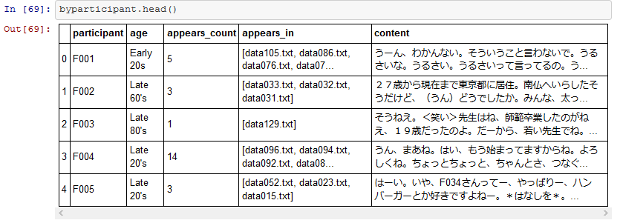
Data Cleaning and Reorganization
Eventually was able to filter dialogue into speaker entries in other dataframe!
Had to use a nested for-loop, unfortunately :( luckily didn’t take too long

Slide 11
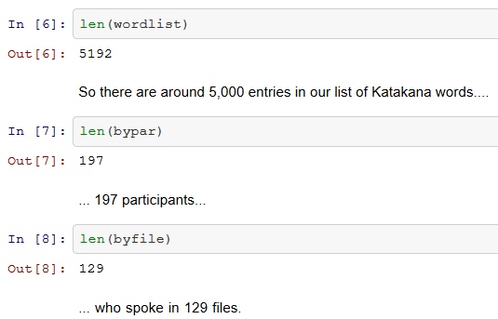
Clean Data Deets
List contained 5192 words
197 total participants
129 different conversations
We aren’t tooootally done yet, though…

Slide 12
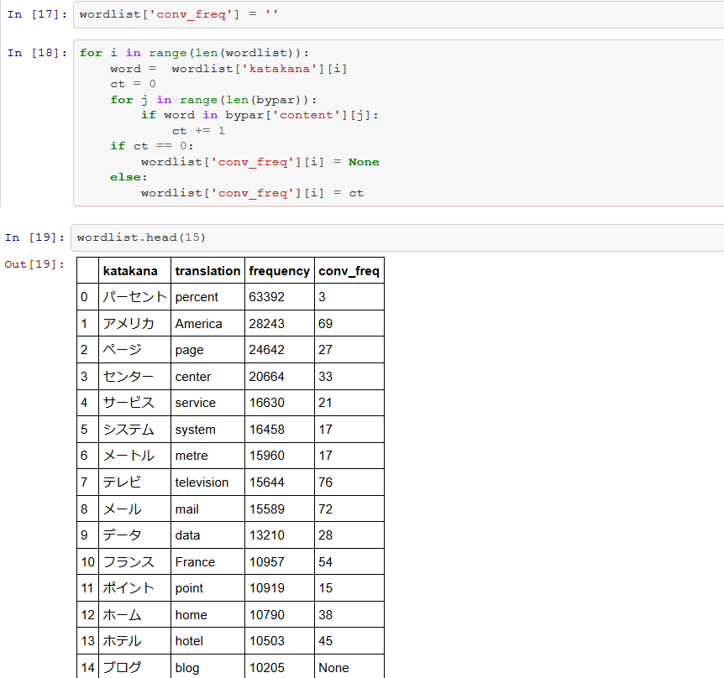
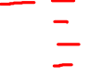
Speeding up the process....
No point in trying to find words that don’t show up in the conversation, right?
2-in-1 process: removing words that don’t appear in the Nagoya conversations while also gathering frequency of the words used to compare web usage to conversational usage
See how the highest-ranked word as far as web frequency goes isn’t that occurrent in casual conversation at all?

Slide 13
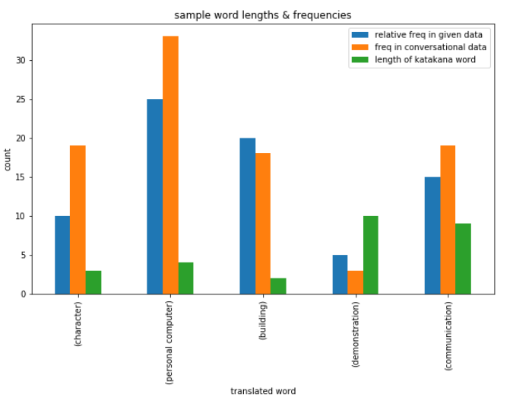

A Peek at Length vs. Frequency
Took a sample of two varieties of words:
Lengthier katakana words that did not shorten from the English version
デモンストレーション (demonsutoreeshon = demonstration)
コミュニケーション (komyunikeeshon = communication)
Shorter katakana words that did shorten from the English version
ビル (biru = building)
キャラ (kyara = character)
パソコン (pasukon = personal computer)
Graphed their length in Katakana, conversational frequency and web frequency
Had to just rank them within those five words for web frequency - those numbers were too big to fit on the graph!

Slide 14
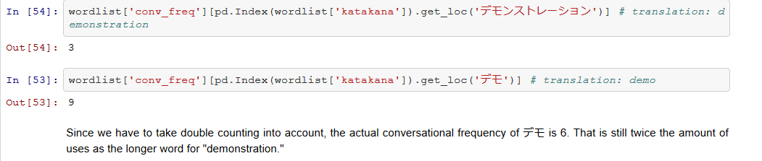
A Peek at Length vs. Frequency
There’s much more to consider here; the word for communication was still more common than one of the shortened words in the conversational data!
Could be because of the conversation topics?
“Demo” vs “demonstration”
“Demo” is more commonly used!

Slide 15
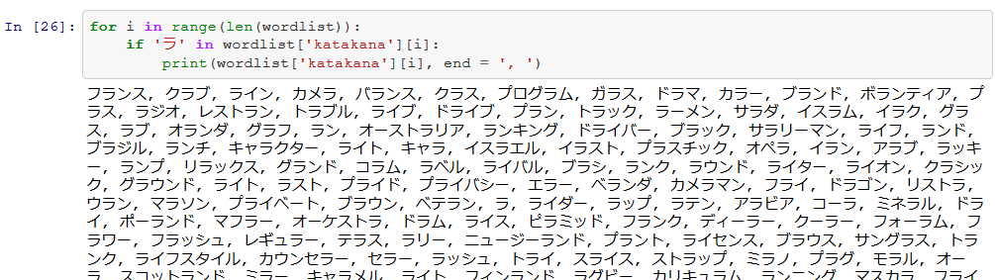

Some potential issues…
Double counting!
No word boundaries in Japanese, so if one word appears within another, it’ll count that instance of a word twice
This occurred with ラ = “ra”/”la” - look at all the words it double counted for ラ!
This is only about half of them…

Slide 16
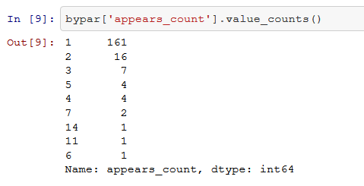
Some potential issues…
Some participants participated way more in the conversations than others
… Way more. One participant participated 14 times
That participant had a ton of data, so it’s possible that she’ll skew everything completely
Uneven age distribution
More younger speakers than older
Younger speakers tended to participate in more discussions than older speakers

Slide 17
Where to go from here
I still need to work on age vs. katakana use, but I might have to try a couple different methods that each have their own pros and cons
Taking ratio of katakana characters to total characters
Pro: avoids outliers
Con: could also count onomatopoeia words - not what we’re looking for!
Counting up how many katakana words each participant uses
Pro: sticks to the list of words, excludes onomatopoeia
Con: prone to outliers and double counting
Maybe test out some machine learning methods, if I find a correlation and don’t run out of time
Multinomial NB? SVC? Gridsearch? We’ll see

Slide 18
ありがとうございます！
arigatou gozaimasu!
Be safe, everyone!

